Slide 1
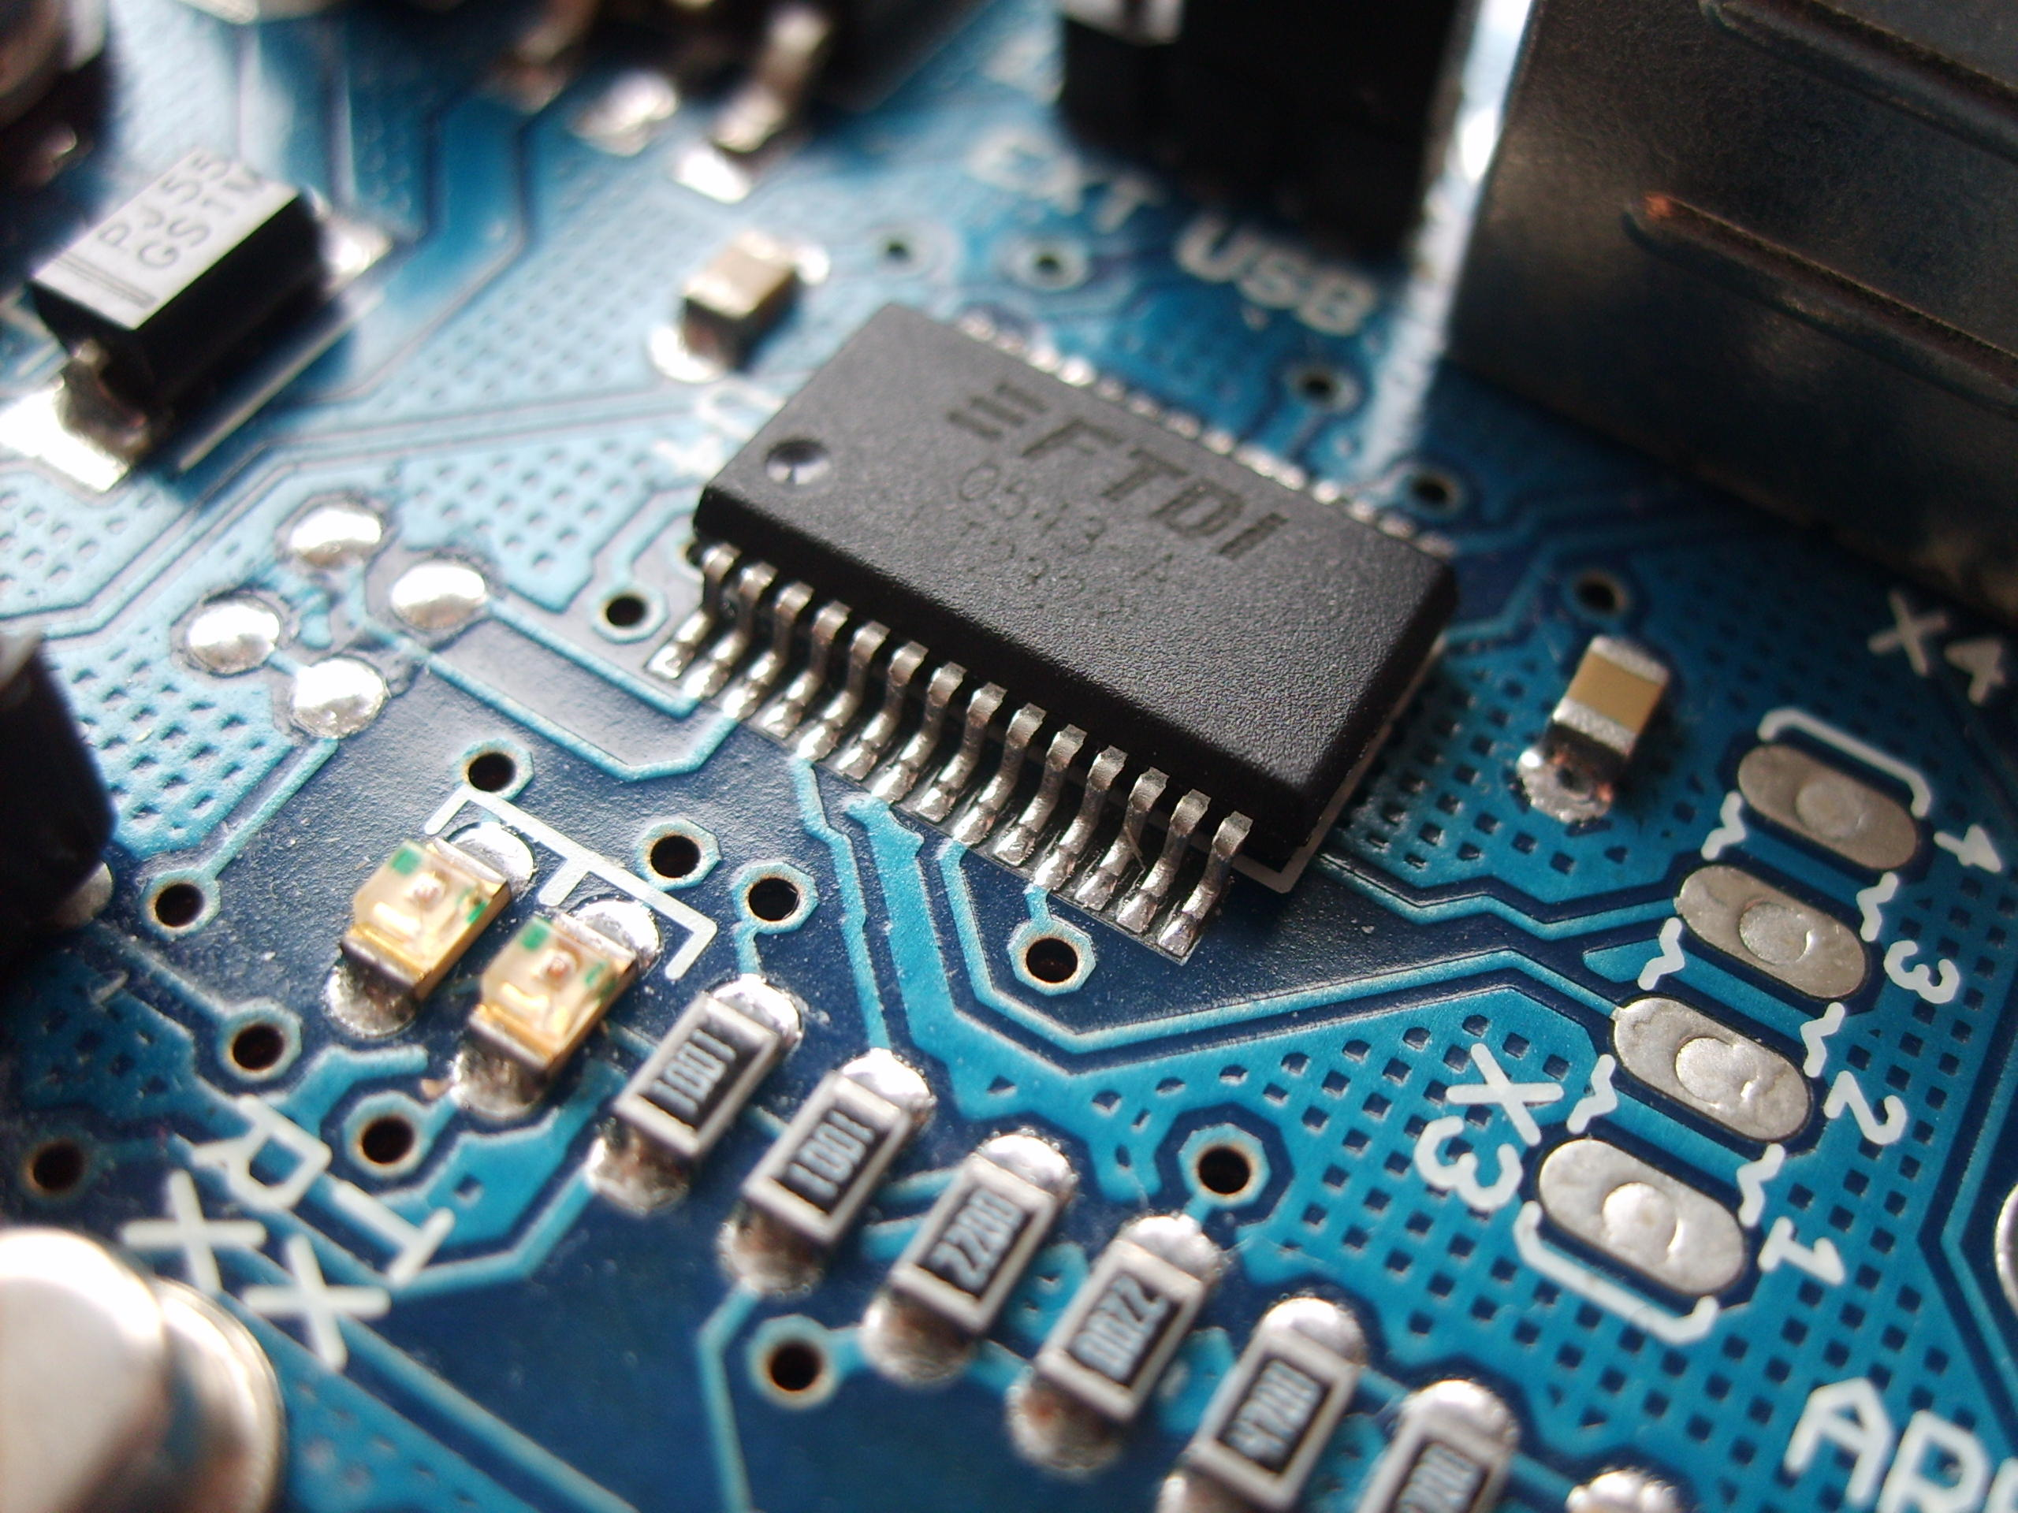
No ,YOU DONT HAVE A
FUTURE IN CORE
Said by most Indian parents, and society
Said by those people who haven’t even
tried to fight their passion, and impose their fears
to other people
Placement talk by
-Ayush Mittal and Shoumik Dey

Slide 2
Why should YOU listen to US ?
Ayush Mittal
I am your Senior
Upcoming intern at Baxter Innovations
College life :
Contributed to AJIT microprocessor development (one of the indigenous processors of INDIA).
3rd position out of 215 teams in E-Yantra Robotic Competition.
Got selected for Indian Academy Of Sciences Summer Research Fellowship.
Central Mechanical Engineering Research Institute (AUVs)
Mars Rover Manipal Member (2018-2020).

Slide 3
Why should YOU listen to US ?
Shoumik Dey
Currently in the 4th year
Incoming intern at Schneider Electric R&D
Experiences gathered during college:
Research Intern at Indian Statistical Institute, Kolkata (CVPR department)
Mentored by Samsung on a project under the PRISM program
Google Summer of Code student (2019)
Alumni of Project Manas

Slide 4
Flow Of Presentation
E-Yantra
Internship
Placements and Internship Experience

Slide 5
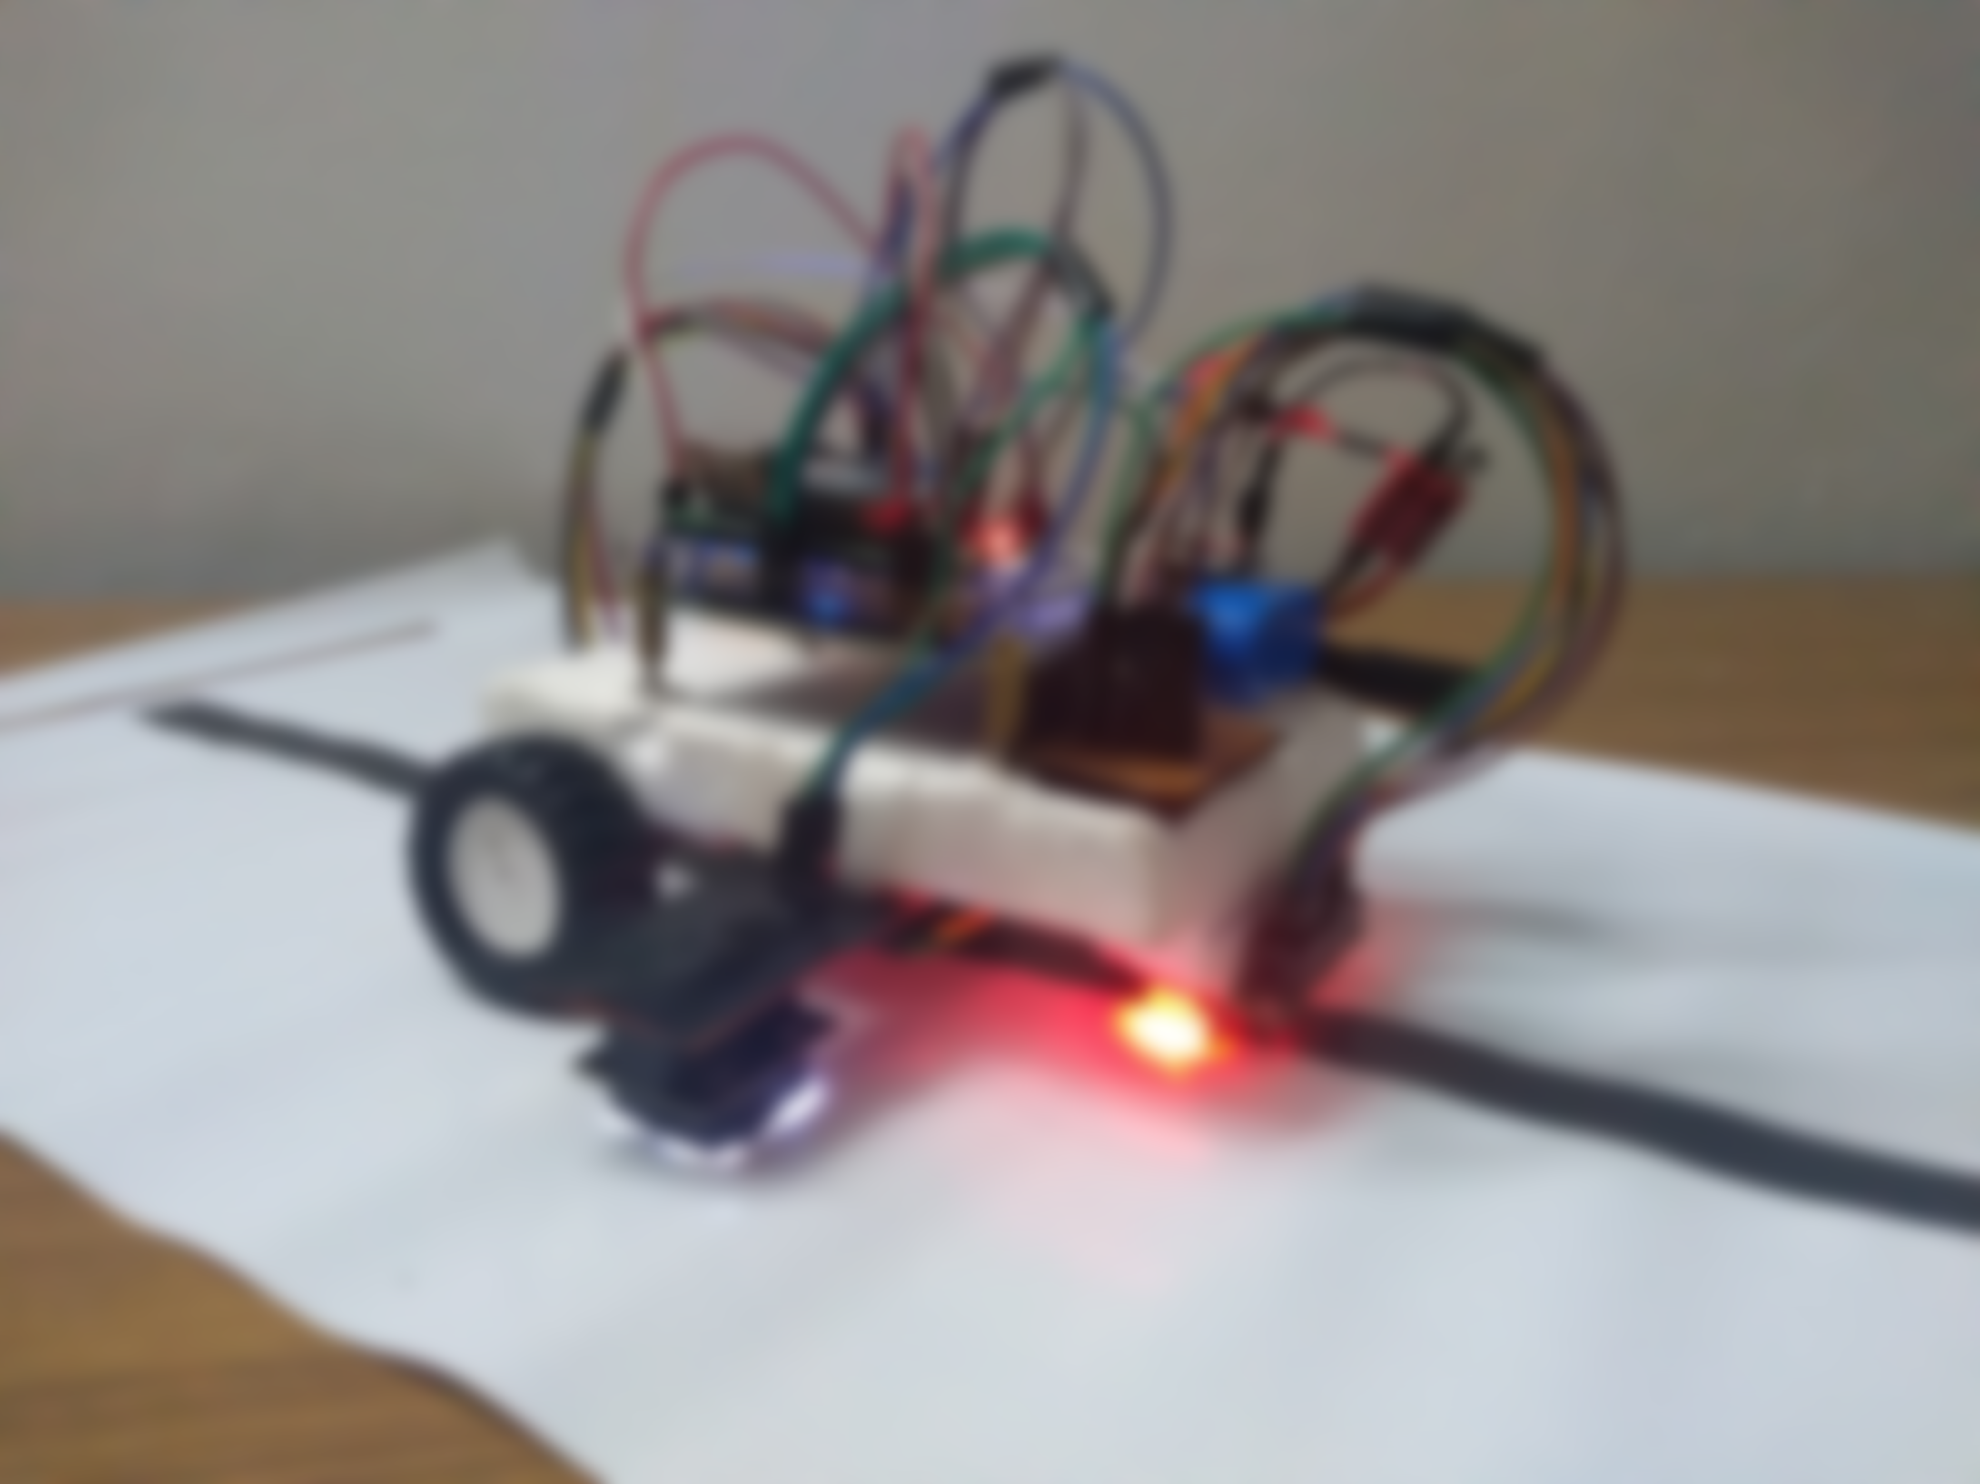

Competition that requires no prior technical knowledge, it only requires determination.
Why E-Yantra ?
Connections you make there are valuable (Innovators, Entrepreneur, Professors).
Placement opportunity.
You get your hands on inside info of IITs, and these info can help you to make better life choices.
Problem: Lots of team leave the competition in the middle.
Don’t leave the competition in the middle, try to solve those problems, you can contact me.
Don’t select a person just because he is good in technical knowledge, look at the character.
Any Queries ?
E-YANTRa
best 400 Rs investment of my life.

Slide 6
Internship AT MIT
You need to have a internship done in the summer break before your fourth year starts.
It is mandatory.
You need to submit a report and do a presentation in 7th/8th sem.
You can also work under a professor at MIT.
Due of COVID it was allowed to work at an educational institute and in virtual. It might be different for you and the future batches.
Any queries ?

Slide 7
I want to get internship without my PARENTS help
Indian Academy Of Sciences, Summer research fellowship. ← Can be your sure shot thing
No test, No interview, it’s just SOP and academic record, last date 30th November.
ayush129/ Opportunities-In-Core-Domain ← Github
Foreign Institutes / IITs
Mail to professors / Company through your official outlook or connect to LinkedIn.
Connect with people (Job Title : talent acquisition).
Every Professor in IITs have their own page at which you can look at their research interest.
Lot of people fail in this approach.
How do I lean to write linkedin messages and mails?
Wait, How do I write these emails. ← Book
5/850 mails = 0.6 %,
1/850 mails= 0.1 %
Google : Research internship for undergraduate github
repo of himahuja ←Goldmine, each and every single line on that repo

Slide 8

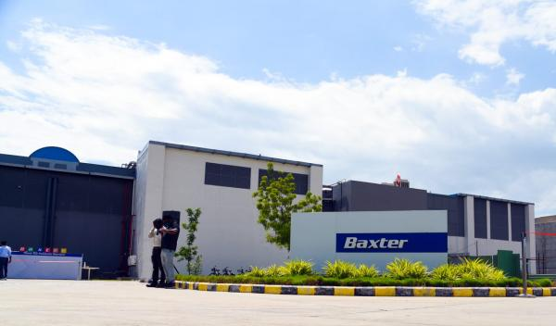




PLACEMENTS AND INTERNSHIP EXPERIENCE

Slide 9
Mainly the opportunities were offered in the domain of :
PCB designing
Graduate Engineer Trainee
VLSI domain

Slide 10
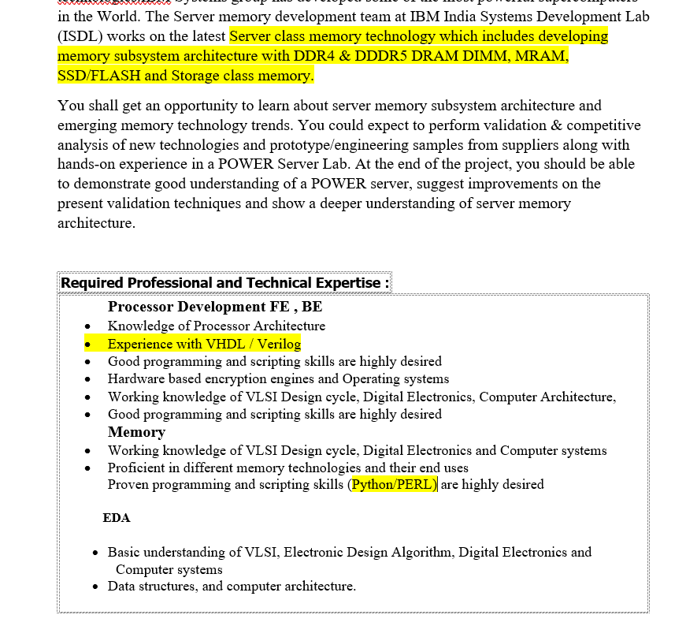
IBM ISDL HARDWARE INTERNSHIP

Slide 11
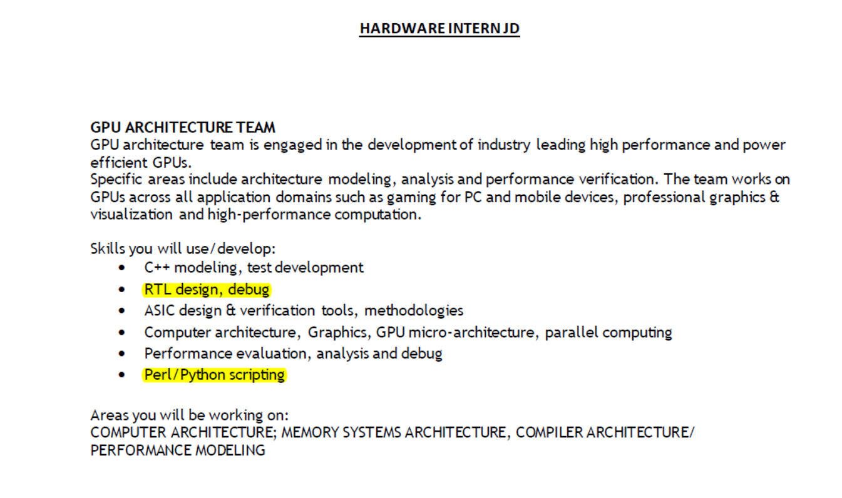
NVIDIA

Slide 12
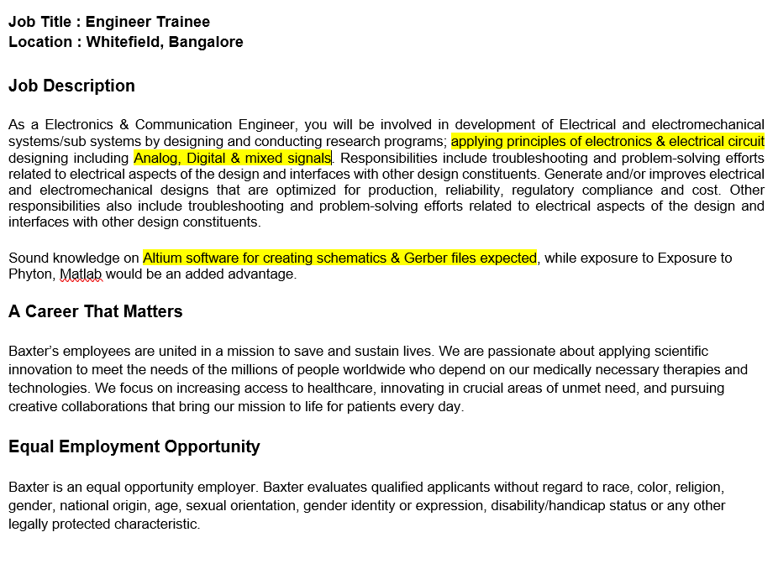
BAXTER INNOVATIONS

Slide 13
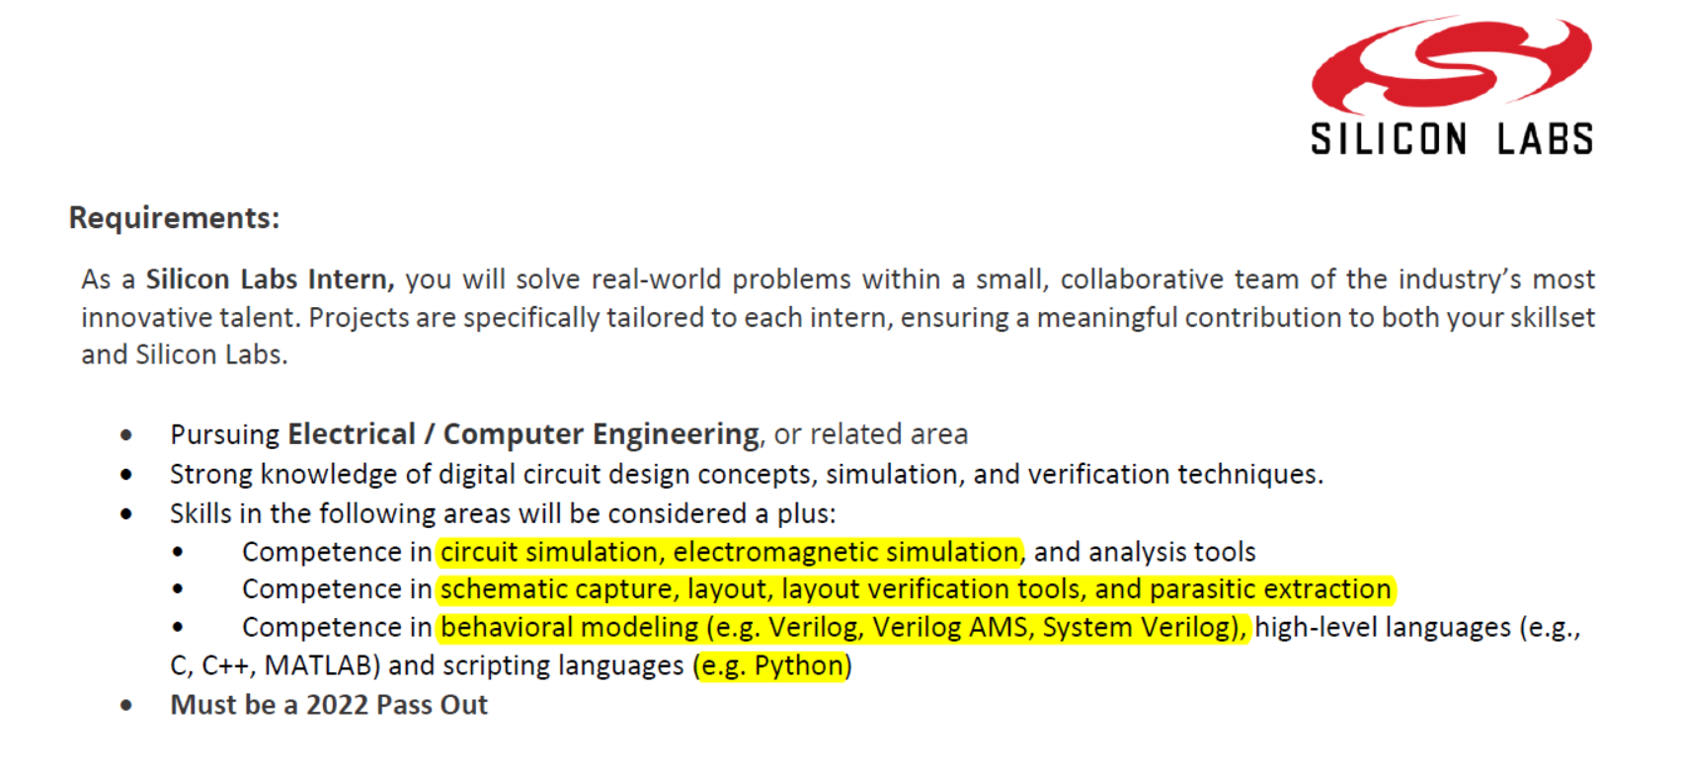
Silicon labs

Slide 14
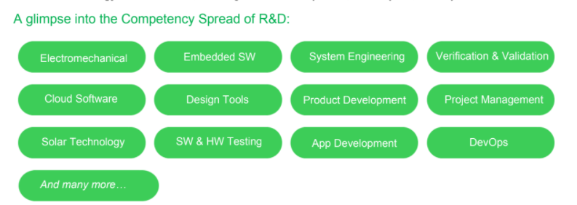
Schneider Electric R&D

Slide 15
Skills Required
VERILOG / VHDL good project
Python / TCL
PCB Designing
Topics To Cover For Test
Digital Electronics + State diagram. ( Neso Academy )
VLSI ( taught in college )
C language MCQs ( Geeks For Geeks )
APTITUDE ( Gate Level )
8085 Architecture and Pinout ( Not the programming )
Puzzles ( Nvidia Interview )
Oscillators, OPAMP, Diodes
Why not analog stuff ?
Important and must for placement’s Interview

Slide 16
Internship EXPERIENCE

Slide 17

GOOGLE SUMMER OF CODE

Slide 18

SAMSUNG PRISM

Slide 19
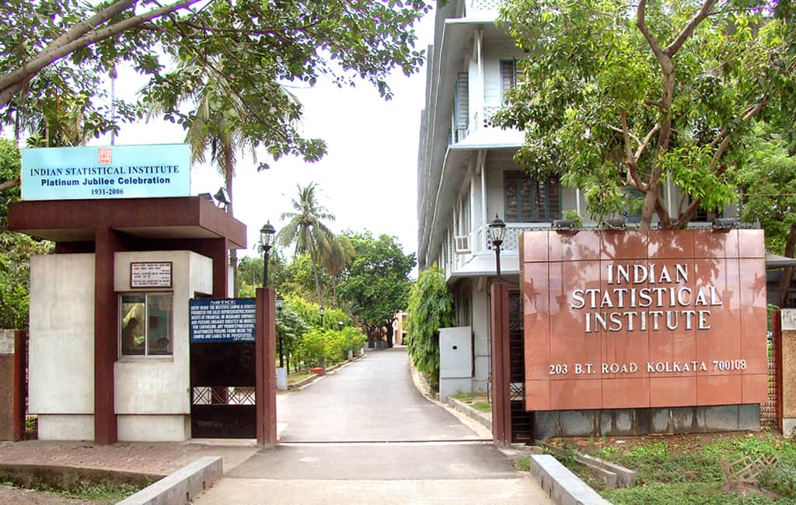
INDIAN STATISTICAL INSTITUTE, KOLKATA

Slide 20
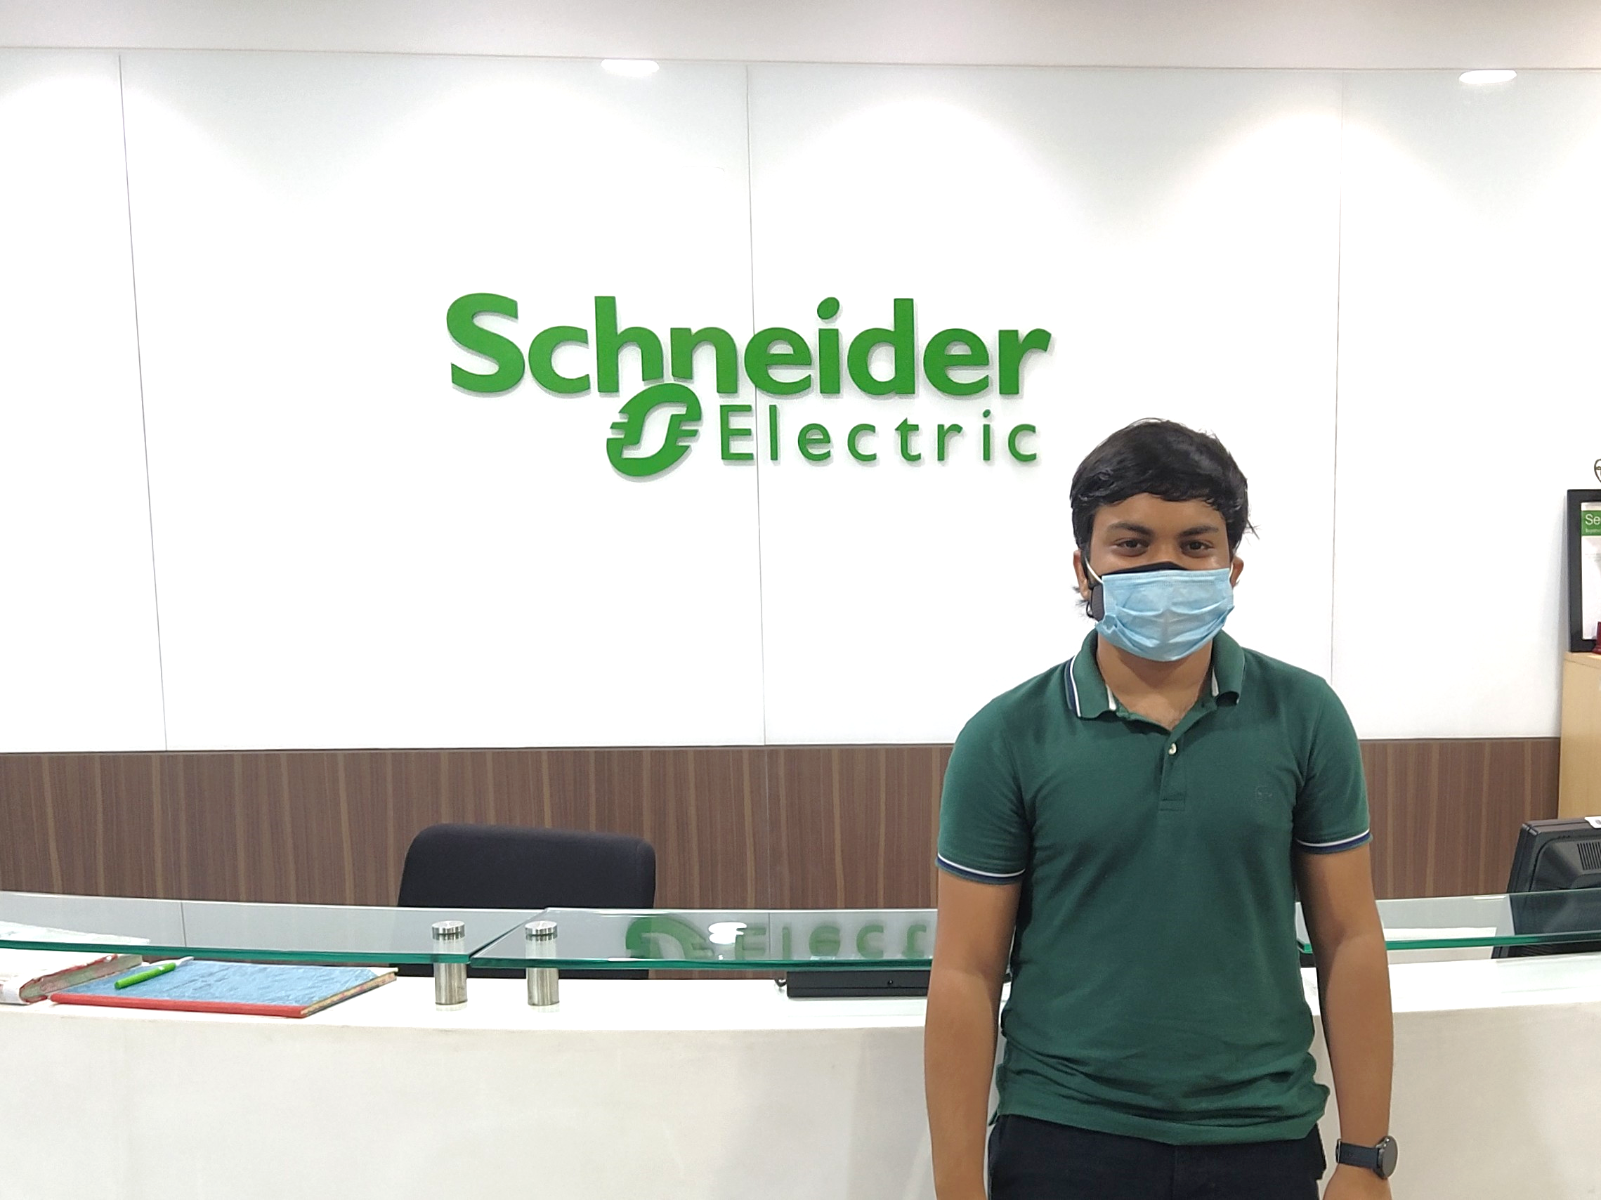
SCHNEIDER ELECTRIC R&D

Slide 21
LITTLE BIT MORE ABOUT BAXTER, NVIDIA and SCHNEIDER ELECTRIC INTERVIEWS
NVIDIA (1 round )
OT-> Fill in the blanks and MCQs
Learn about the products they have
More emphasis on Sequential Circuits.
Setup Time and Hold time analysis (Def and Num)
How they are resolved
Faults , hazards and violations
FSM
Sequence detectors
Clock skew
FIFO Depth
CMOS Design
Types of memories
COA cache design concepts
DSA / Coding
Questions from paper (Flip flops)
2 Quizzes
Sequential circuits
Some people grinded over CV
They are leaders in AI so be carefull if you
mention about it.
BAXTER/Schneider Electric (2/3 rounds)
CV Based , explain the project
Tested problem solving ability
Managerial questions
ADC , MCUs , Diodes
Hobbies, questions related to it
Family Background

Slide 22
INTERVIEW PREPARATION
Prepare your CV well.
Very basic question and logic behind about your project.
Assume that they dont have your CV, tell everything from yourself.
FIRST QUESTION OF EVERY INTERVIEW : tell me about yourself.
( Name, interest , projects , thoda sa softskills )
Why a company ? Don’t give a generalised ans like work culture is good and all, give a personalised ans.
Best way to research about a company : Youtube channel
Don’t tell about your masters
Find about the person who is taking your interview, (Linkedin), helps you in asking personalised question
Always ask good questions in the end.
Don’t study technical one night before the interview. Prepare the ans for general CV questions.
Don’t show your attitude to them, remember your etiquettes,
You can go some extra mile ………. Only when your interview went good (comes in etiquettes)
Retrospect your failed interview , compare with people who got through it.

Slide 23
REALITY CHECK
People ruin their placement experience because of desperation.
So don’t be desperate either for a girl or placement.
Its not about the hard work that you have done in all these 3 years, placement tests
your emotional character.
Advice for 3rd years : its time to get into the depth , exploration time is over
Advice for rest , can still explore but try to begin your depth journey as soon as possible
Hardwork
Patience
Luck
Success

Slide 24
THANK YOU
Wish you a bright and prosperous future ahead !!
Ayush Mittal
mittalayush129@gmail.com
Shoumik Dey
shoumikdey123@gmail.com

